Slide 1
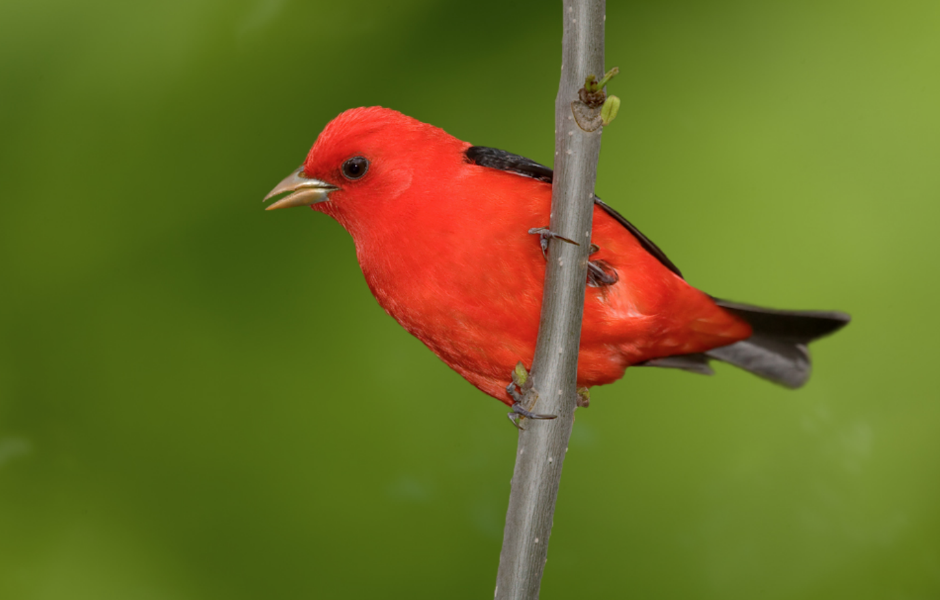
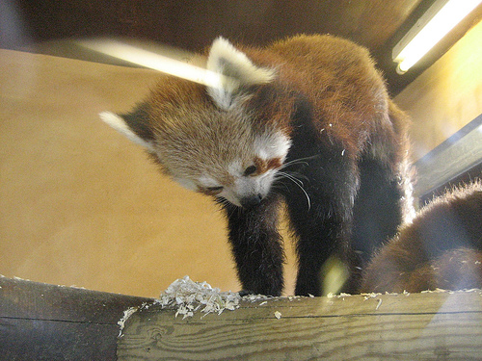
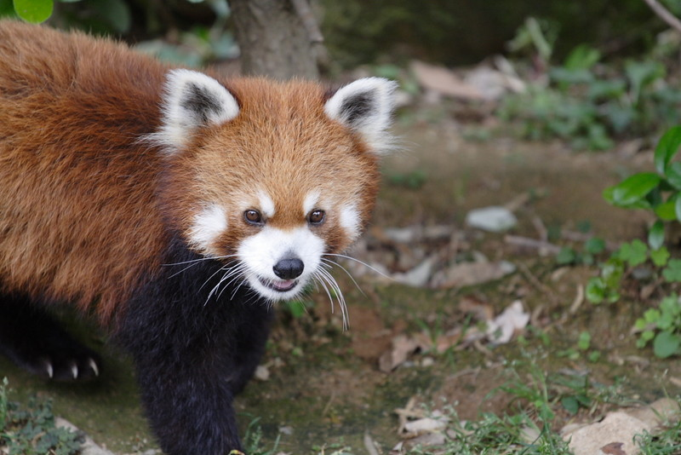
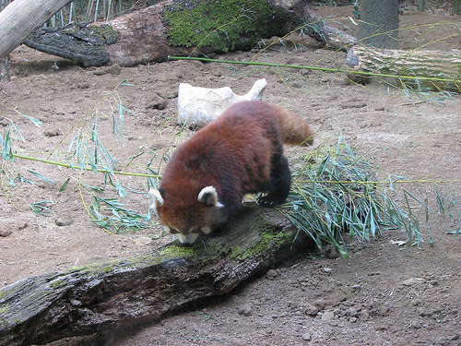
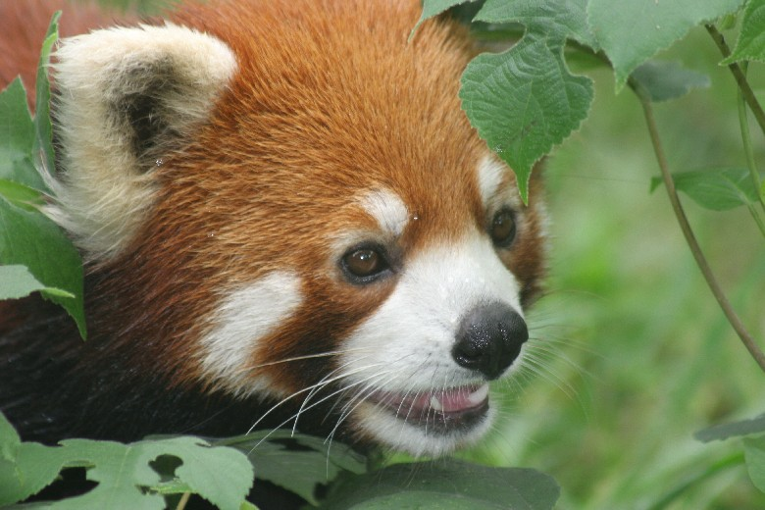
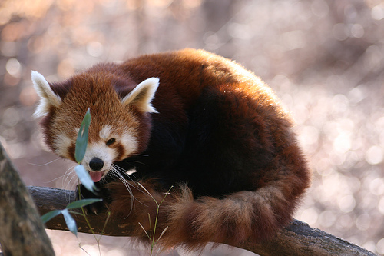
Closed-set recognition
?
?
?
?
Training Set
Open set recognition

Slide 2

T
is the combination of global average pooling + ReLU + convolution
T
T
T
Input
Stage_1
Stage_2
Stage_3
Stage_4
Average
operation

Slide 3

T
is global average pooling + ReLU + 1x1 convolution
T
T
T
Stage_4
Stage_3
Stage_2
Average
Input
Stage_1
operation

Slide 4
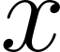
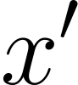
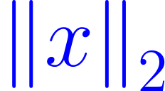
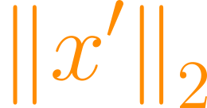
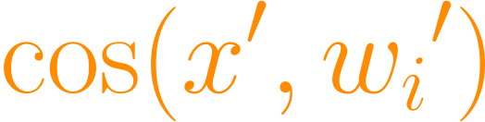
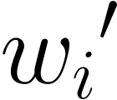
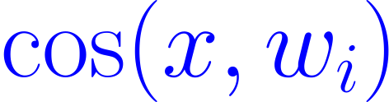
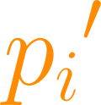
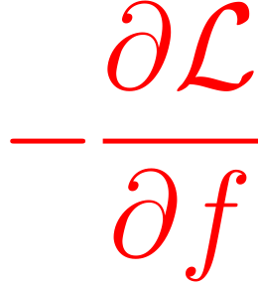

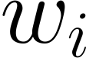

Slide 5
Class 1 data
Class 2 data
Unknown data
w₁
w₁
Decision
Boundary
Decision
Boundary
w₂
w₂
Unknown threshold
Original softmax
Projection-softmax

Slide 7
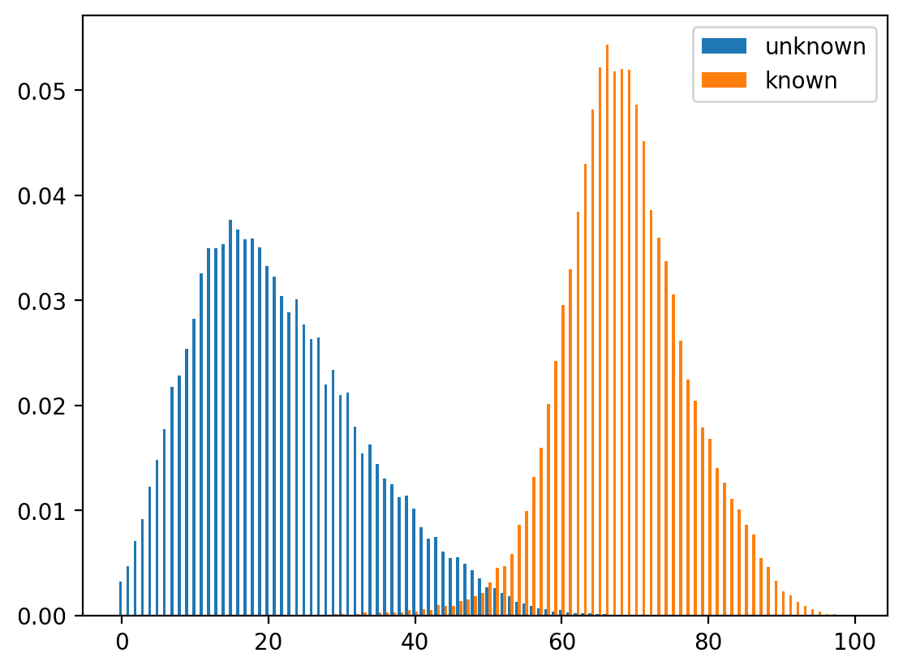
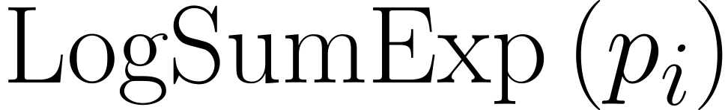
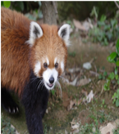
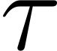
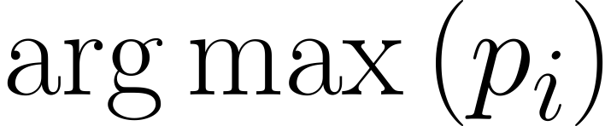
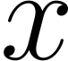
Unknown rejection
panda
raccoon
Known recognition
cat
squirrel
…
Feature Vector
dog
CNN Backbone
p-softmax

Slide 8
Unknown rejection
panda
raccoon
Known recognition
cat
squirrel
…
Feature Vector
dog
CNN Backbone
p-softmax

Slide 9
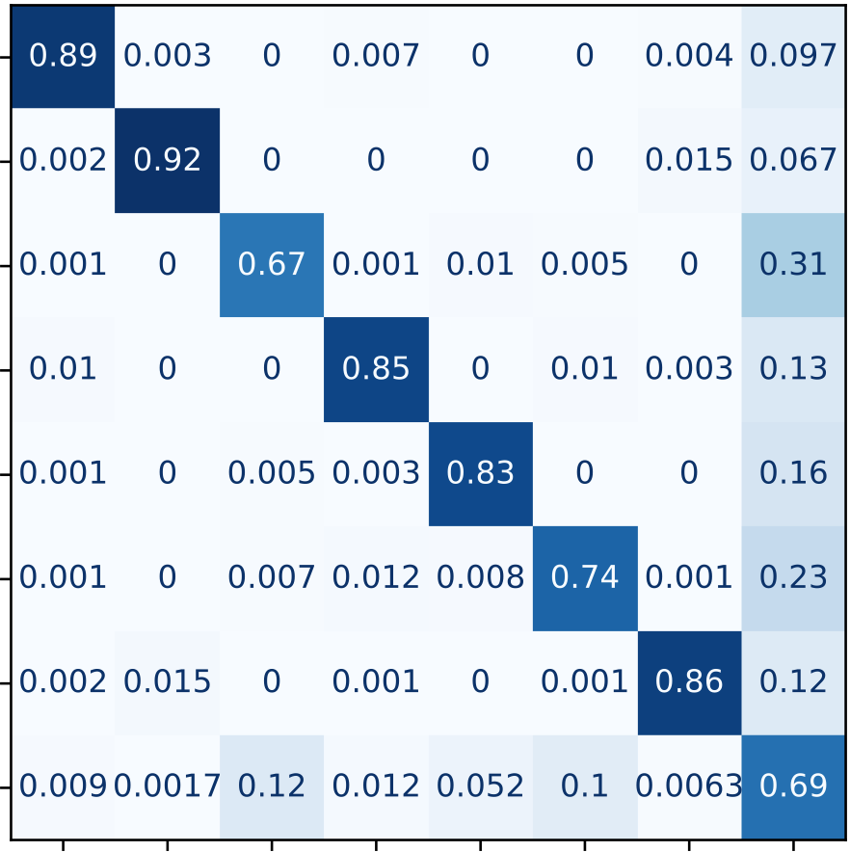
ship
auto
dog
plane
horse
bird
truck
unk
ship
auto
dog
plane
horse
bird
truck
unk

